Slide 2
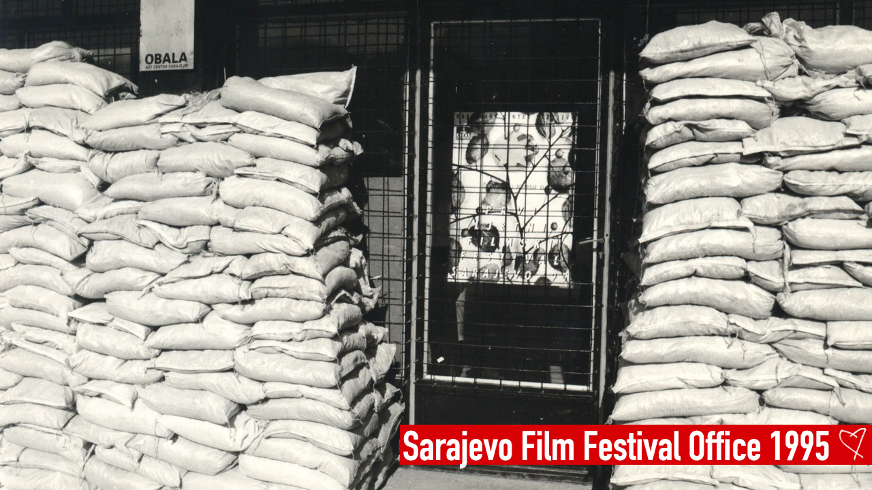

Slide 4
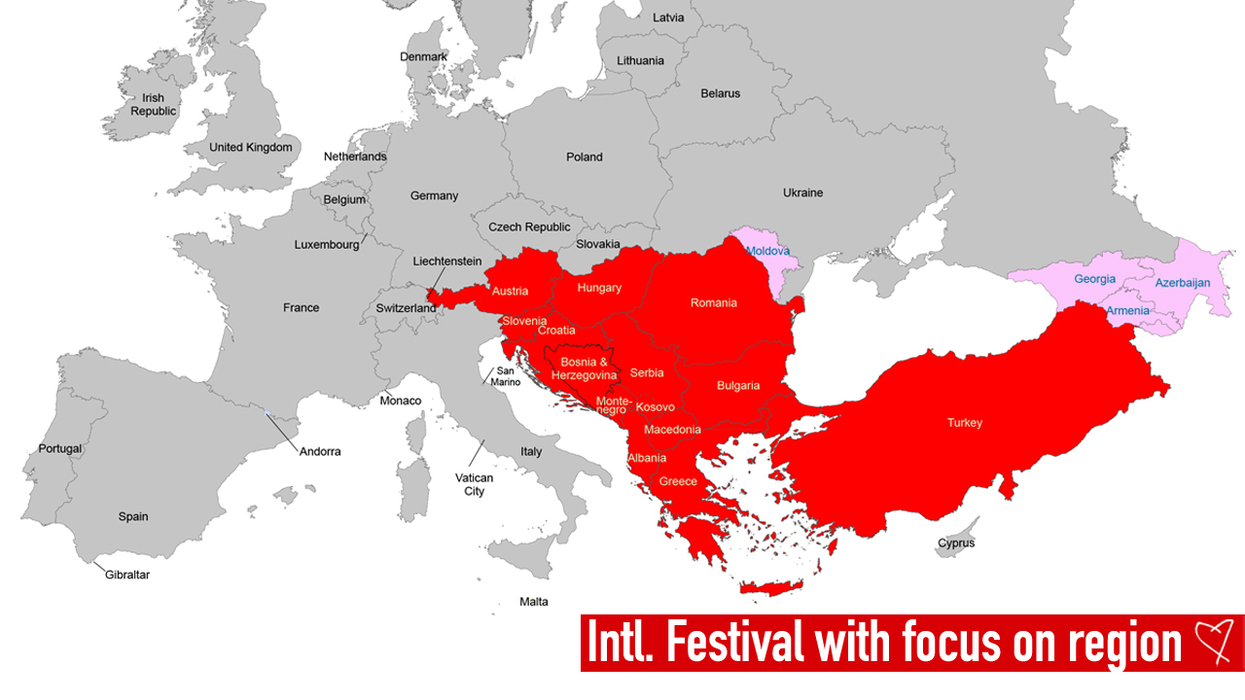

Slide 5
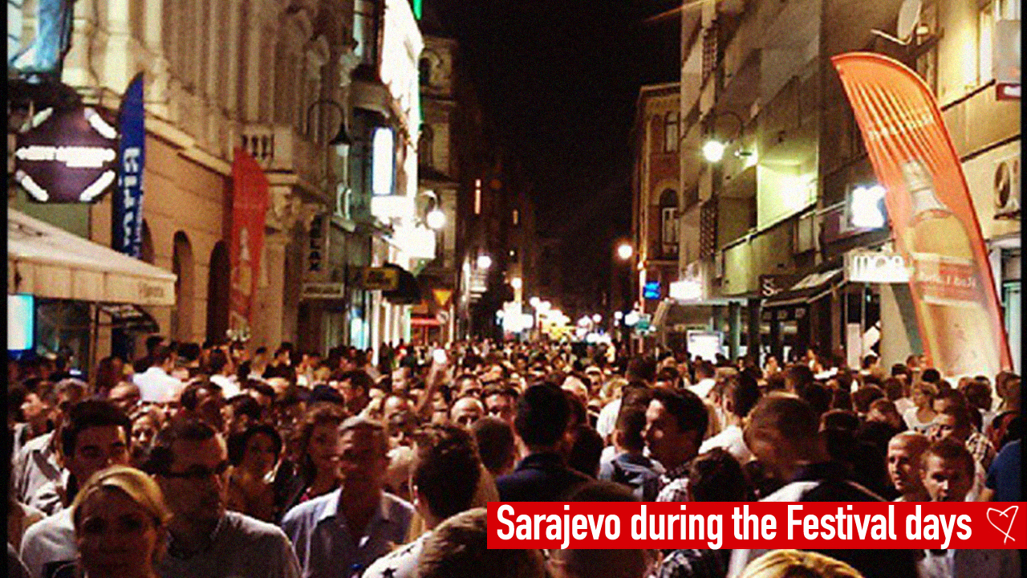

Slide 6
Social Impact – the Perception of Sarajevo
Audience Survey – impact of SFF on the perception of Sarajevo
91%
of the Audience felt the SFF had a positive impact on the perception of the city
1984 Olympics
were the event most commonly noted as a comparison to the SFF
Notes:
Through its activities, the SFF has significantly altered the perception of Sarajevo and Bosnia and Herzegovina, both as seen domestically and from abroad
Respondents to our consultation and survey underlined this, with the SFF placed alongside the 1984 Olympics in terms of its impact on the city by multiple stakeholders and residents
The activities of the SFF help to drive tourism to the city, as our economic impact figures demonstrated, and generate an atmosphere in Sarajevo which is not felt at other times of the year

Slide 7
Economic Impact
The SFF directly generates a significant economic impact for the City of Sarajevo, and for Bosnia and Herzegovina
 |  | Output | Employment | GVA
2019 | Direct | BAM 6,04 m | 25 FTEs | BAM 690,851
 | Total | BAM 13,88 m | 89 FTEs | BAM 2,54 m
2018 | Direct | BAM 4,40 m | 21 FTEs | BAM 651,485
 | Total | BAM 10,14 m | 73 FTEs | BAM 2,40 m
2017 | Direct | BAM 4.49 m | 28 FTEs | BAM 508,531
2017 | Total | BAM 10.33 m | 99 FTEs | BAM 1.87 m
In total, the Festival employs approximately 300 people on part-time contracts every year.
The Festival is also a major source of tourism for the City of Sarajevo
 | Impact | Employment
Direct | BAM 14.00 m | 396 FTEs
Total | BAM 57.60 m | 1,438 FTEs
Notes:
The calculated values underestimate, however, the actual scale of the employment generated by the Festival
In 2017, Obala Arts Centar had 15 full-time members of staff; the remaining FTEs were spread over the large number of part-time staff brought onboard to handle the highly labour-intensive running of the Festival itself
In total, 250 people are hired on part-time contracts for this purpose
During the 2017 SFF, the Tourism Board of the Canton of Sarajevo recorded 30,000 tourists to the city during this period
We conservatively estimate that 10,000 of these individuals attended the Festival
Using existing data on tourism impact, we find a direct impact of BAM 14 million, which generated a total impact of BAM 51.6 million, with 1,385 FTEs

Slide 8
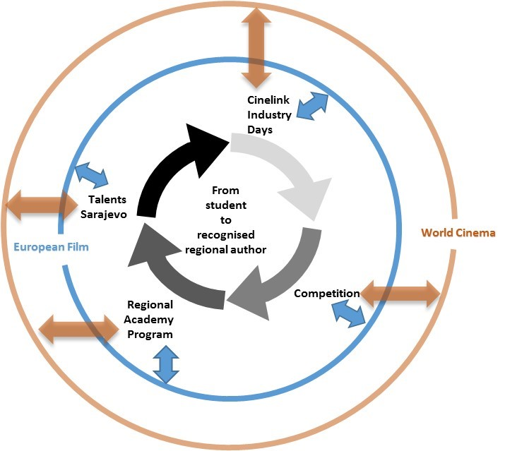

Slide 9
Cultural Impact – Funding and Co-Producers
The SFF is also perceived by the industry as a critical place for finding funding and co-producers for projects
Industry Survey – SFF’s value for funding and co-production partners
85%
of Industry stating that the SFF is a good location for finding SEE co-producers
73%
of Industry stating that the SFF is a good location for finding co-producers from the Rest of Europe
Notes:
The results of our Survey also show that the SFF is a very positive place for finding co-producers and funding for future productions

Slide 10
Cultural Impact – the SEE Film sector
The Industry perceives that the impact of the SFF on the South Eastern European film sector has been strong and positive
Industry Survey – impact of SFF on the volume of production
83%
of Industry stating that the SFF had a positive impact on production quality
168
Cinelink-supported projects selected for major international film festivals
Notes:
The SFF also plays a vital role for the development of content and the film sector, particularly for the South-Eastern European region
A strong plurality of content at the festival comes from this region, and the widespread perception is that without the activities of the Festival, the entire film sector in the region would be much weaker
This underlines the value which the activities of the SFF generates for the regional film industry

