Slide 1
The Social&Creative Community supporting ChIMERA project
Crescenzo Antonio Marino, Puglia Region

Slide 2
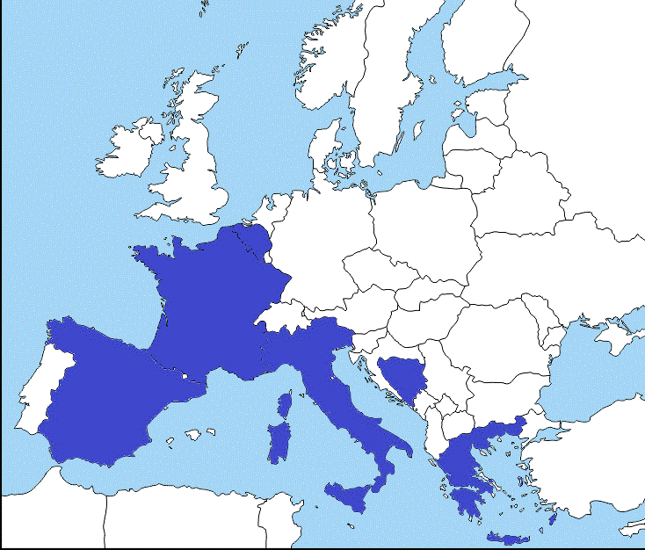
TALIA horizontal project
November 2016 – October 2019
1.499.040 €
6 partners from 6 European countries
with the support of

Slide 3
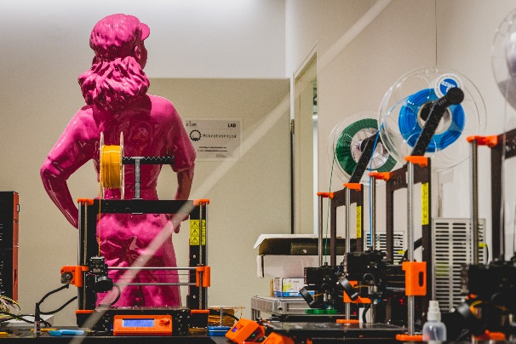
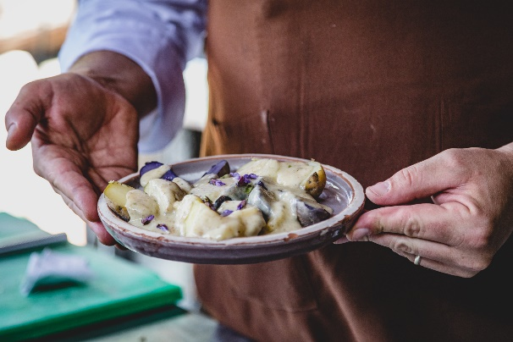
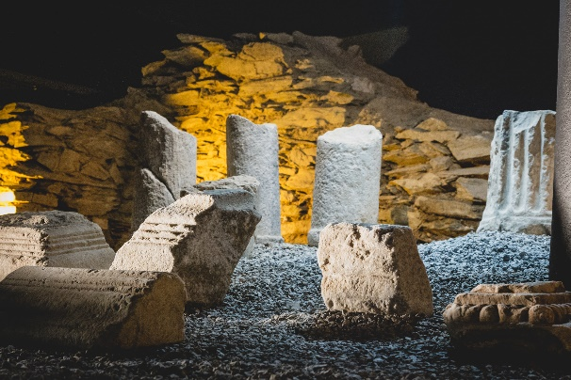
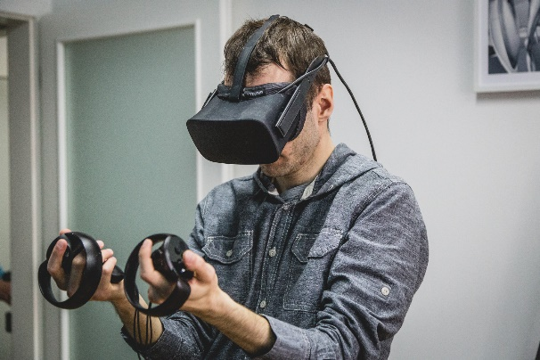
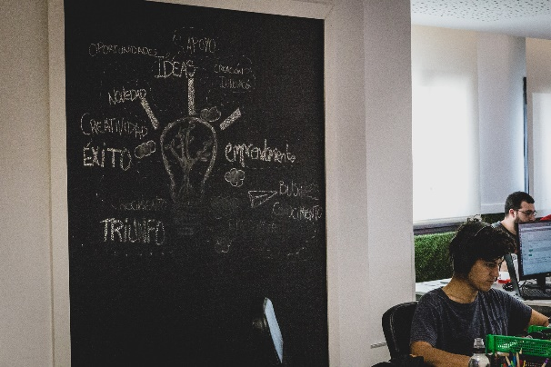
The S&C Community - Topics

Slide 4
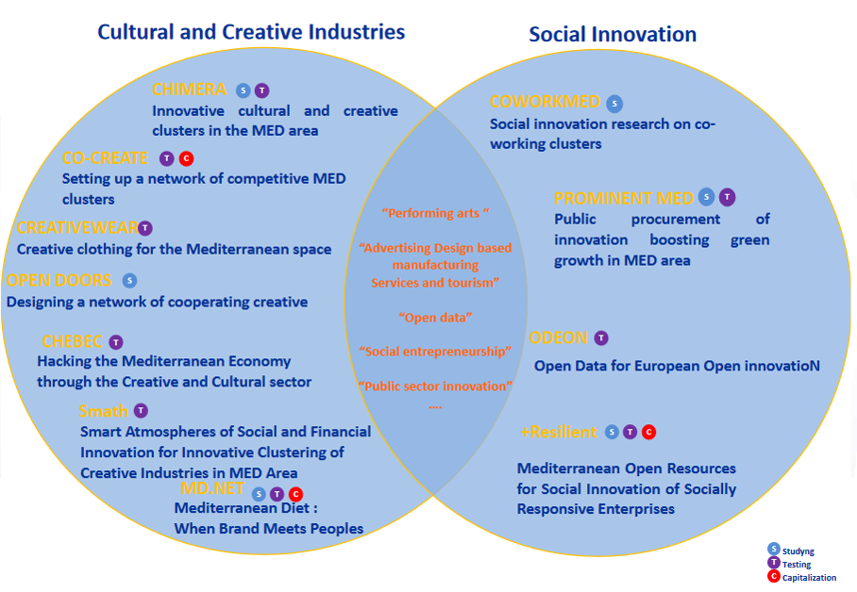
The S&C Community - MPs

Slide 5
The S&C Community - Actions
Engagement and support
Liaison and interaction with modular projects and their local and transnational networks, with the purpose of community building, as well as helping them to interact with each other and their target audiences
Communication
Web spaces for interaction and dissemination among researchers, practitioners, and policy makers
Attaining impact
Identification of opportunities to extend the most prominent results across the MED space and the EU thematic policy agendas
Regular events at the local, national and international levels

Slide 6
Tangible results – Semantic framework

Slide 7
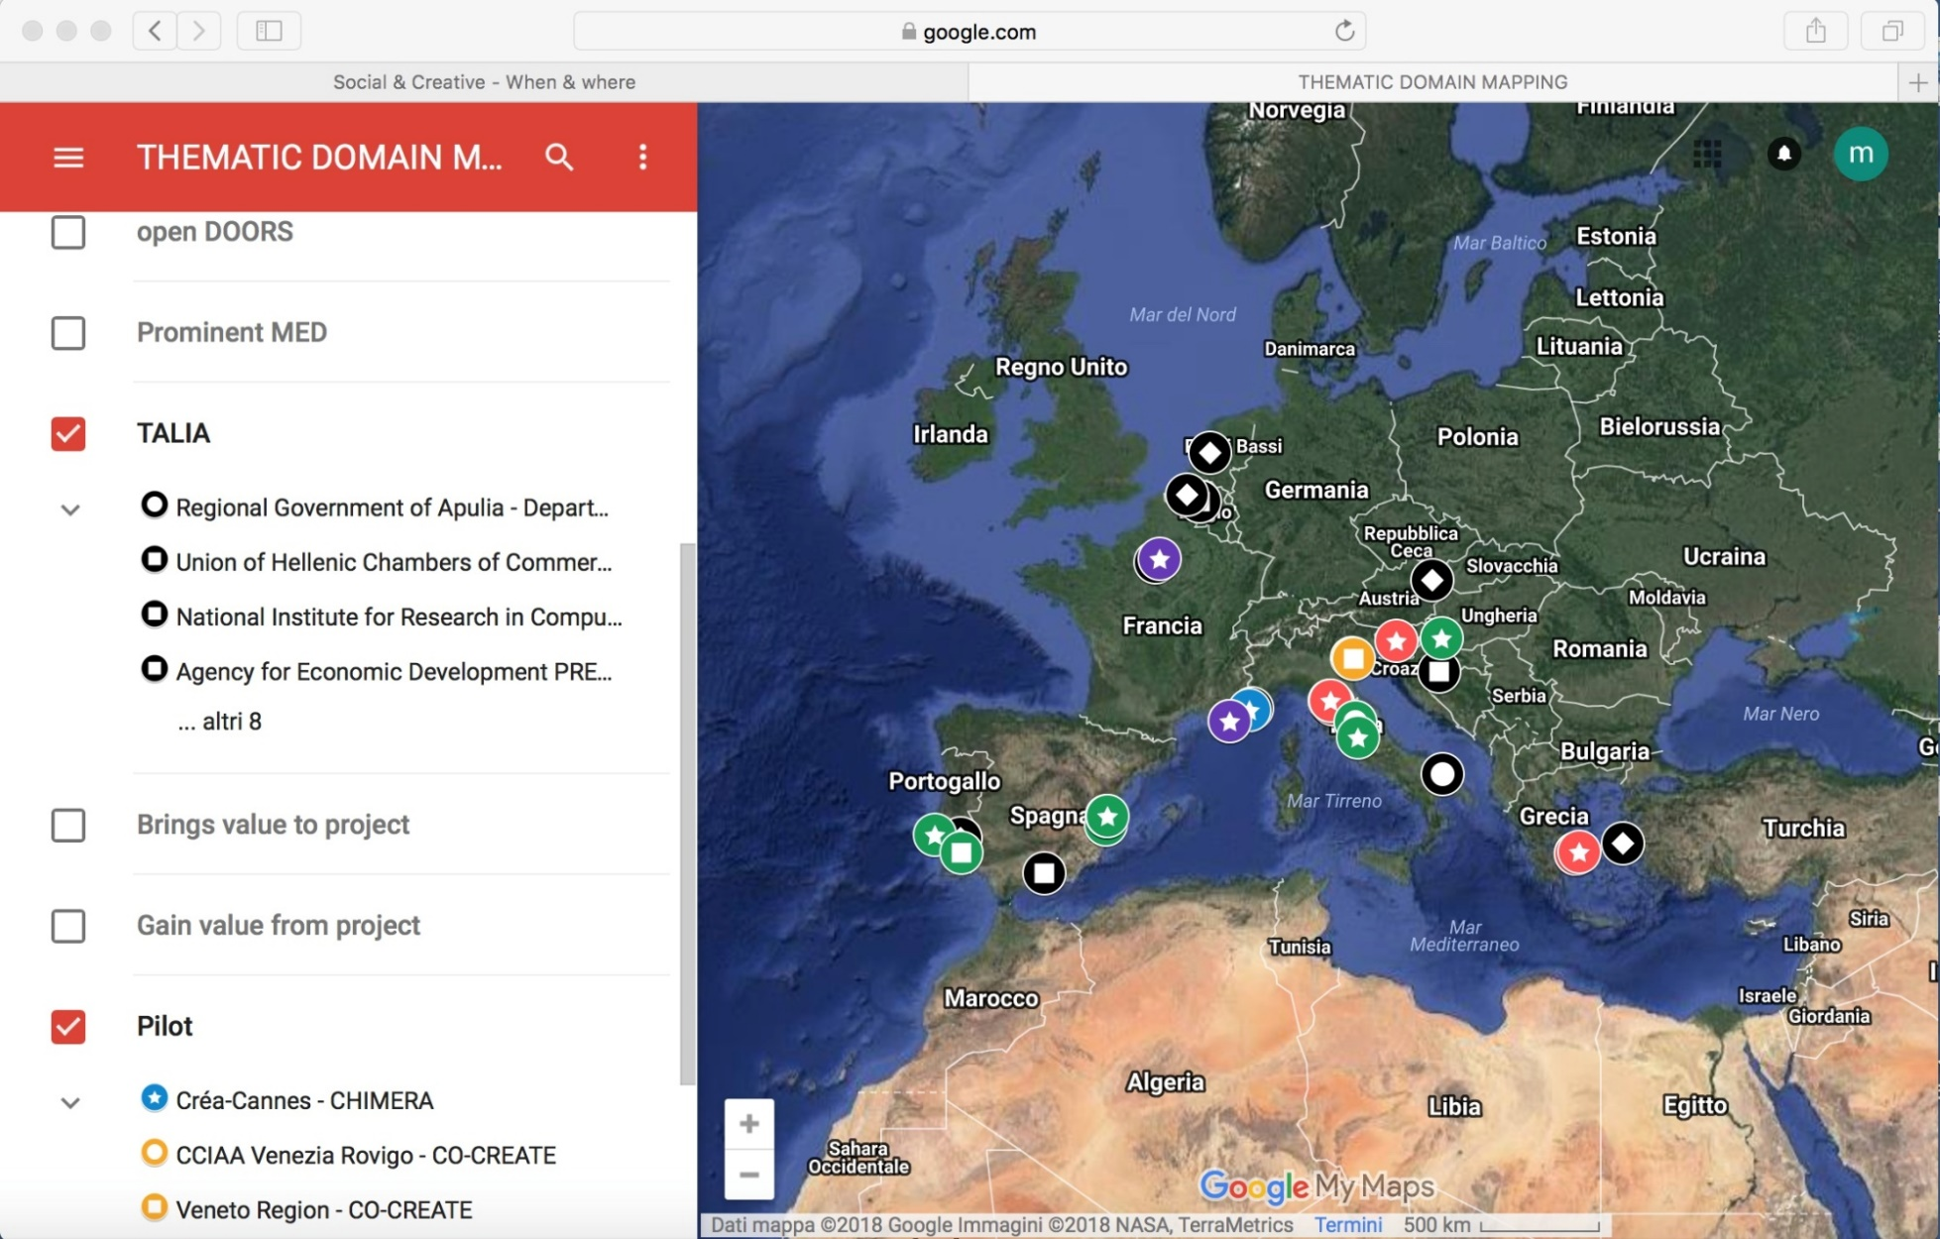
Tangible results – Thematic mapping

Slide 8
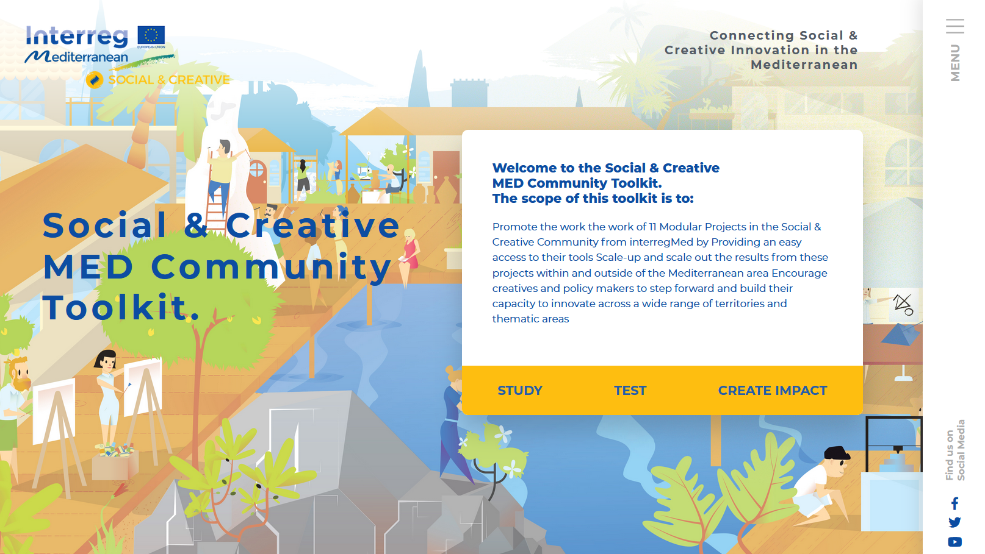
Tangible results – Learning toolkit

Slide 9
The S&C Community & ChIMERA
Engagement and support
TALIA International seminar (Ljubljana, October 2017)
Communication
Newsletters
Attaining impact
Policy briefs
Community YearBook
Project cases
Semantic framework
Thematic mapping
Learning toolkit
Study visit to vertical project (Puglia, March 2017)
Interreg MED Programme Made in MED (Rome, April 2018)

Slide 10
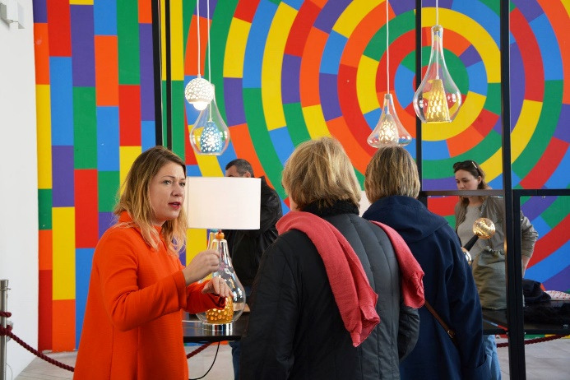
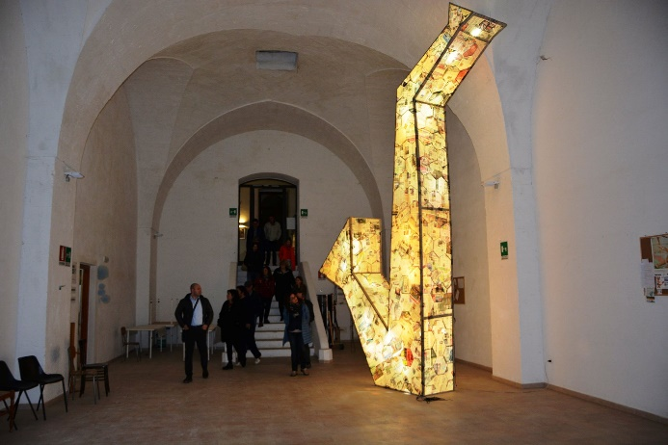
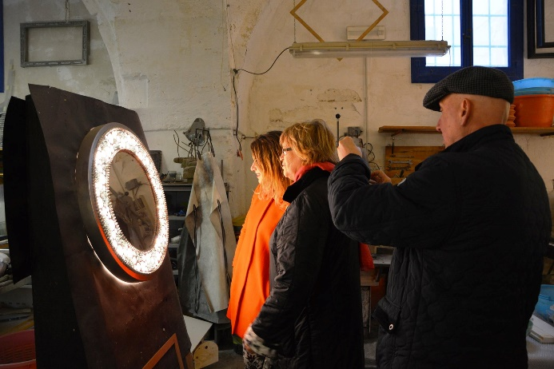
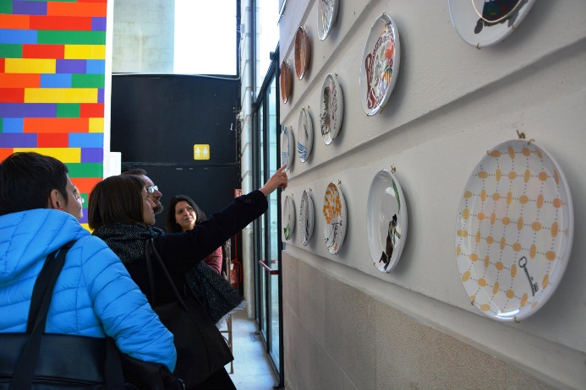
The S&C Community & ChIMERA
Engagement and support

Slide 11
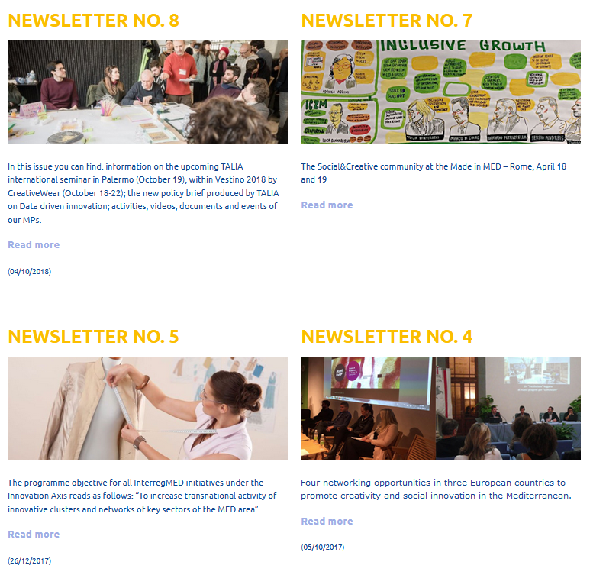
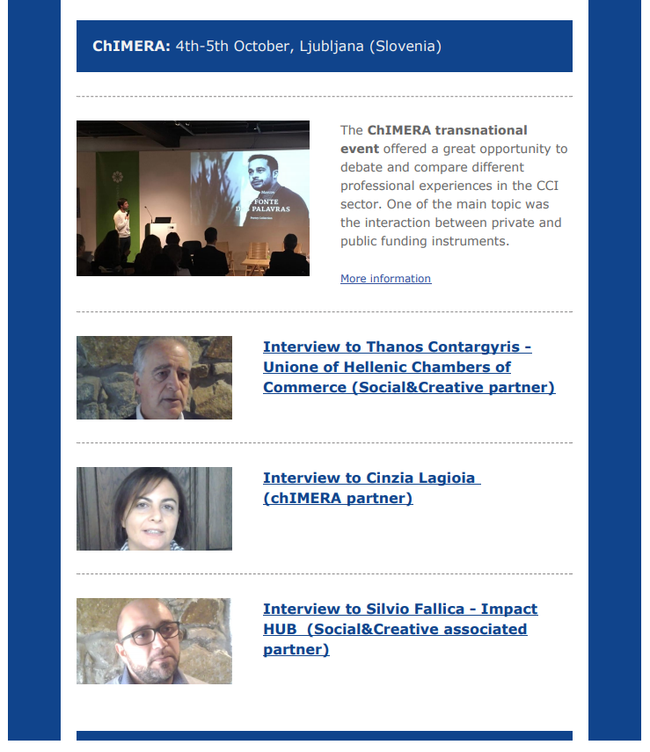
The S&C Community & ChIMERA
Communication

Slide 12
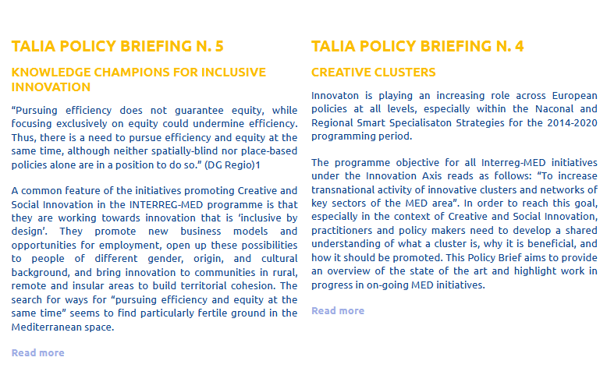
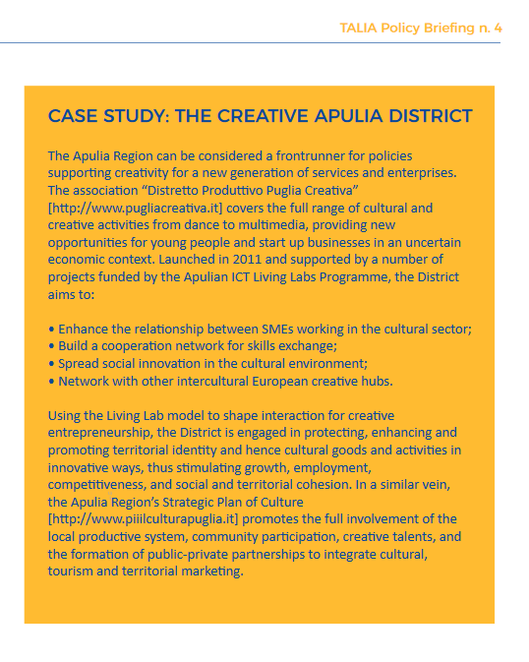
The S&C Community & ChIMERA
Attaining impact

Slide 13
Thank you

