Slide 1
PUGLIA CREATIVA RESULTS

Slide 2
WHO IS PUGLIA CREATIVA (APULIA CREATIVE CLUSTER ASSOCIATION)

Slide 3
WHO IS PUGLIA CREATIVA (APULIA CREATIVE CLUSTER ASSOCIATION)
APULIA CREATIVE CLUSTER ASSOCIATION is the FIRST example of a cultural and creative CLUSTER recognized by a region in Italy.
2012: our starting point
A private network of more than 150 cultural and creative industries:
Performing arts
Cultural industries (audiovisual, publishing, software and gaming)
Creative industries (design, multimedia, architectures
Heritage (visual art, cultural hub, cultural heritage)

Slide 4
4.3 PILOT ACTION 2: SERVICES FOR INTERATIONALIZATION
MATCHMAKING OF CULTURAL AND CREATIVE ENTERPRISES IN THE MED AREA
BARI, 24-25TH OCTOBER 2018
ITALY
FRANCE
SPAIN
SLOVENIA
PORTUGAL
GREECE
COUNTRY | NUMBER OF ENETRPRISES | REGION
ITALY | 46 | FRIULI PUGLIA BASILICATA
SPAIN | 13 | ANDALUCIA CATALUNYA
SLOVENIA | 8
FRANCE | 4
PORTUGAL | 3 | ALGARVE
GREECE | 1 | STEREA
TOTAL | 75

Slide 5
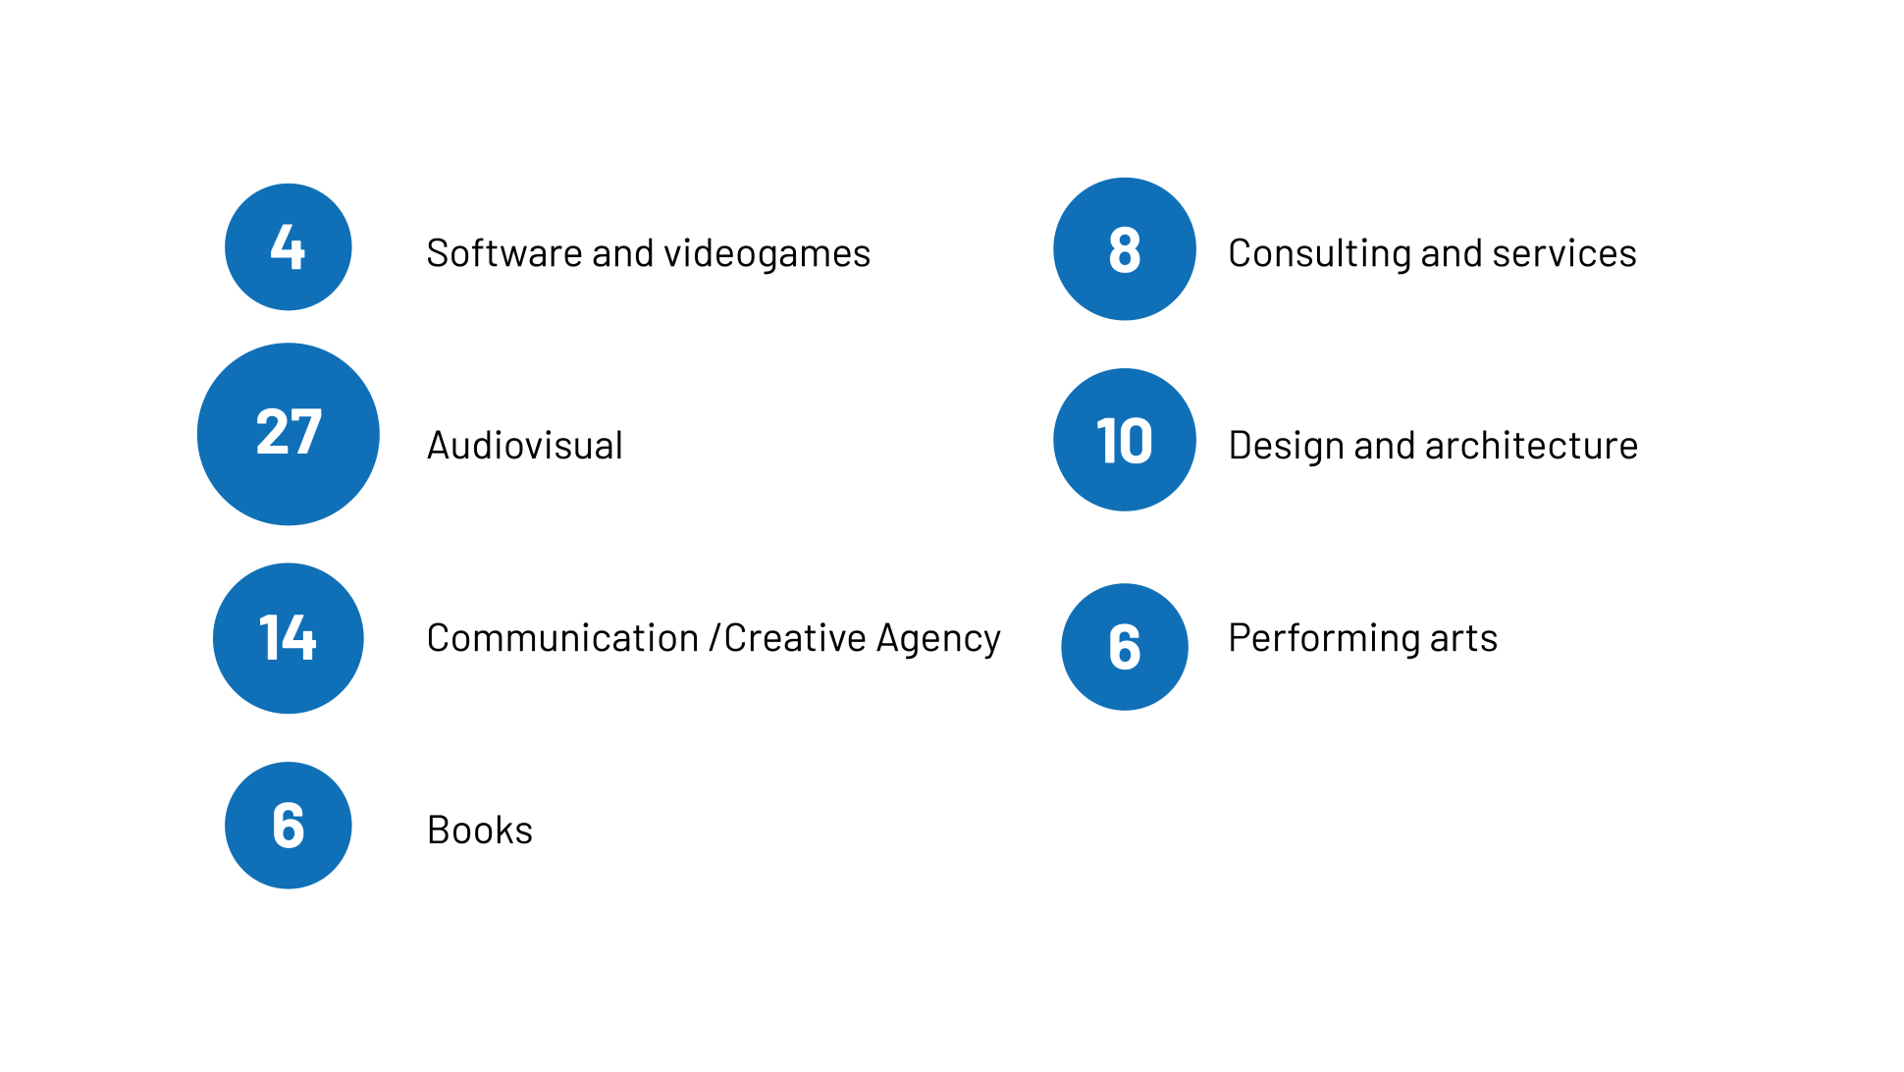
4.3 PILOT ACTION 2: SERVICES FOR INTERATIONALIZATION
MATCHMAKING OF CULTURAL AND CREATIVE ENTERPRISES IN THE MED AREA
BARI, 24-25TH OCTOBER 2018
7 subsectors involved
148 meetings between the participants
111 transnational meetings
37 national meetings.

Slide 6
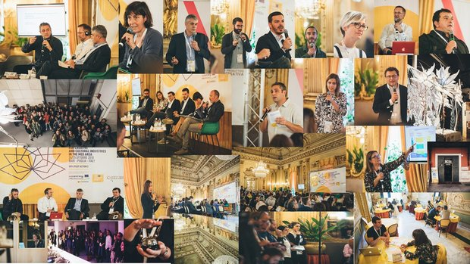
4.3 PILOT ACTION 2: SERVICES FOR INTERATIONALIZATION

Slide 7
4.5 PILOT ACTION 4: LIVING LABS - GOALS
THE STRATEGIC GOALS OF THE LIVING LABS IN CHIMERA PROJECT ARE:
TO SUPPORT the development of creative-digital-inclusive communities and CCI clusters
TO CO-CREATE, develop, validate, test innovation projects
TO BUILD UP COOPERATION NETWORK
for skills exchange and knowledge integration.

Slide 8
LIVING LAB: STEPS
BOOTCAMP 6TH JUNE 2018 – POLIGNANO A MARE
DESIGN WORKSHOP 30TH NOVEMBER 2018 – LECCE
INNOVATION CAMP 15TH FEBRUARY 2019 – FOGGIA
Experts:
Donato Macario
Lucia Lazzaro
LET’S EXPLORE THE METHODOLOGY USED

Slide 9
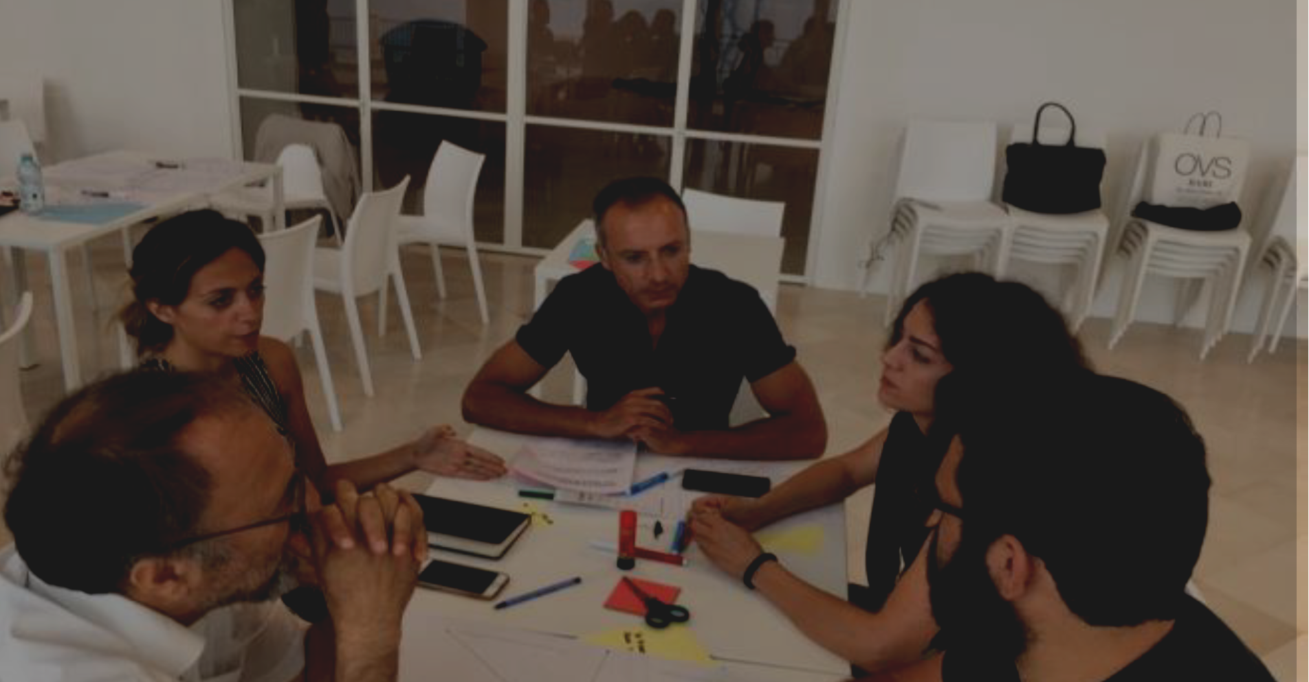
DEFINITION OF
THE CONTENTS
Web platform
GAP ANALYSIS AND SWOT ANALYSIS
PROTOTyping

Slide 10
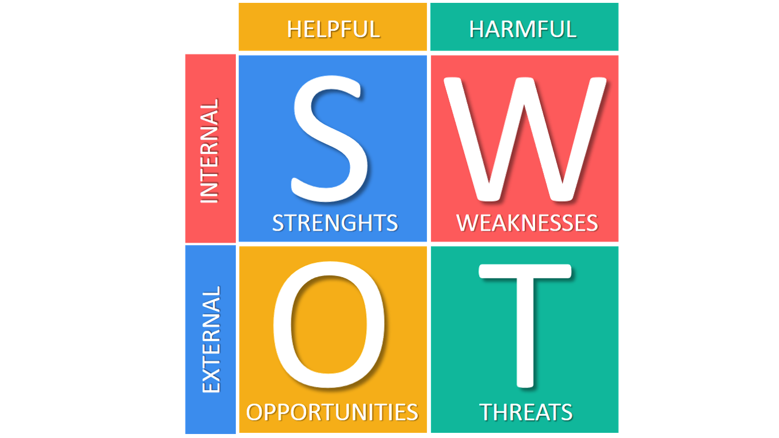
LIVING LAB: GAP ANALYSIS AND SWOT ANALYSIS

Slide 11
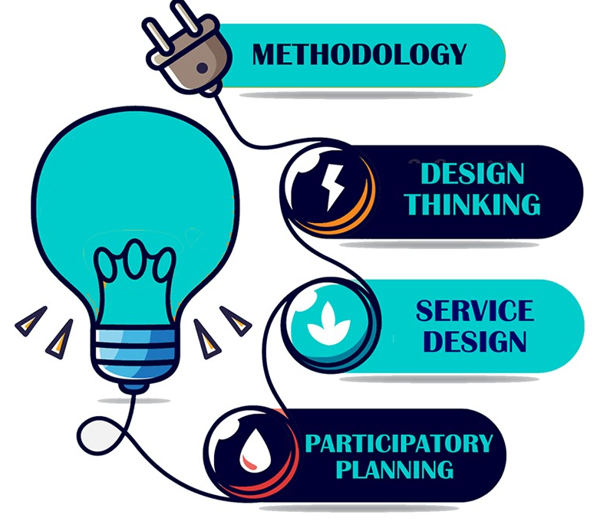
LIVING LAB: DEFINITION OF THE CONTENTS

Slide 12
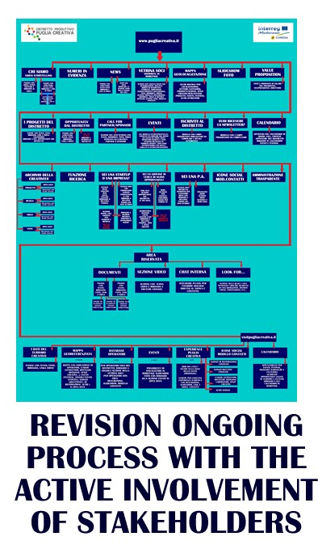
LIVING LAB: PROTOTYPING

Slide 13
LIVING LAB: THE INNOVATION SERVICE

Slide 14
LIVING LAB: THE INNOVATION ASPECTES

Slide 15
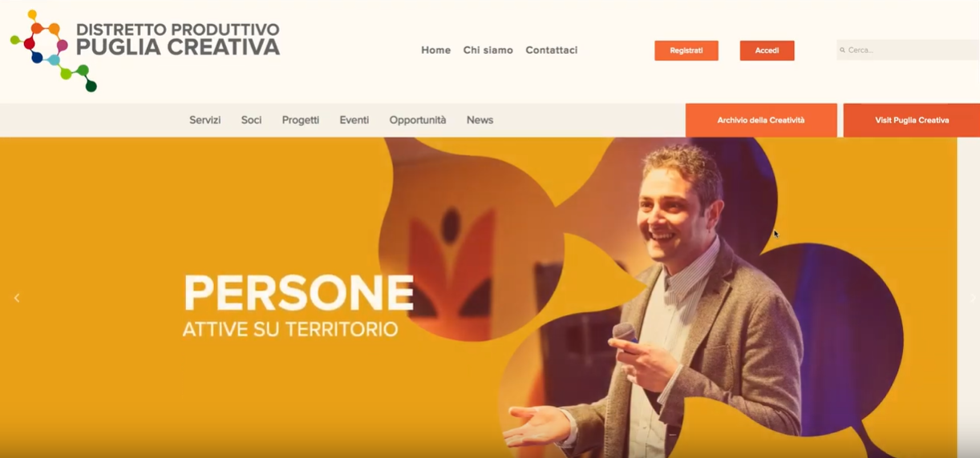
LIVING LAB: THE RESULT

Slide 16
VIRTUAL COMMUNITY
We have activated the VIRTUAL COMMUNITY using a Linkedln group:
https://www.linkedin.com/groups/8585410/
Many participants have already
joined it but we can do more!!!
We invite all partners to:
Interact Share materials
Add the expert that run the Living Lab

Slide 17
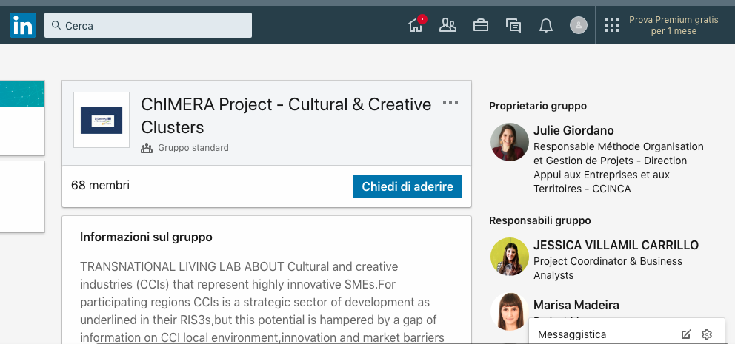
VIRTUAL COMMUNITY

Slide 18
ChIMERA
Innovative cultural and creative clusters in MED area
THANK YOU

